Slide 1
A Comparative Analysis of Wages in the USA BaNa 610 fall 2023
Ida Karimi
Rithvik V Sourab
Venkat Amit Kommineni
Vekata Sai Akshith Kumar Bathula

Slide 2


Wages play a pivotal role in overall wellbeing, extending beyond mere financial compensation. Adequate wages motivate employees to perform at their best. When individuals feel fairly compenPlease let me know if any changes are needed. sated, they are more likely to invest effort and commitment into their work.

Slide 3

Artificial Intelligence (AI) has revolutionized various industries, and the demand for AI professionals is soaring. Employers seek candidates with technical skills, practical experience, and a passion for innovation. Whether through formal education or practical training.
Machine Learning Engineer
Data Scientist
AI Research Scientist
AI Ethics Consultant
Robotics Engineer
AI Product Manager
AI Solutions Architect
Software Engineer
Data Analyst
Computer Vision Engineer

Slide 4
In this project two datasets have been analyzed to compare AI job salaries in the USA with the average wages.
The Wages by Education dataset provides insight into the average hourly wages of workers in the USA within the last 3 decades.
Wages by Education in the USA (1973-2022) (kaggle.com)
The Global AI Data Salaries dataset, provided by AI-jobs.net, is regularly updated with new data on a weekly basis
Download AI, ML, Data Science salary data | ai-jobs.net

Slide 5
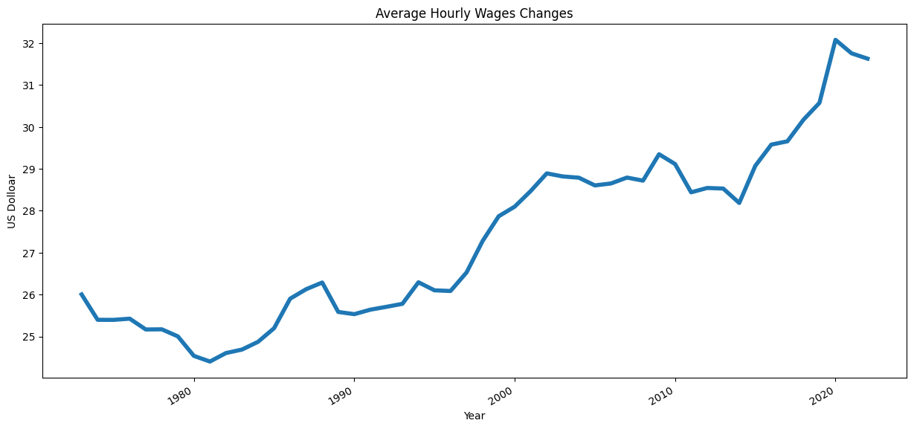
This chart illustrates the growth of average hourly wages in the united states over the past three decades, with figures denominated in thousands of dollars.

Slide 6
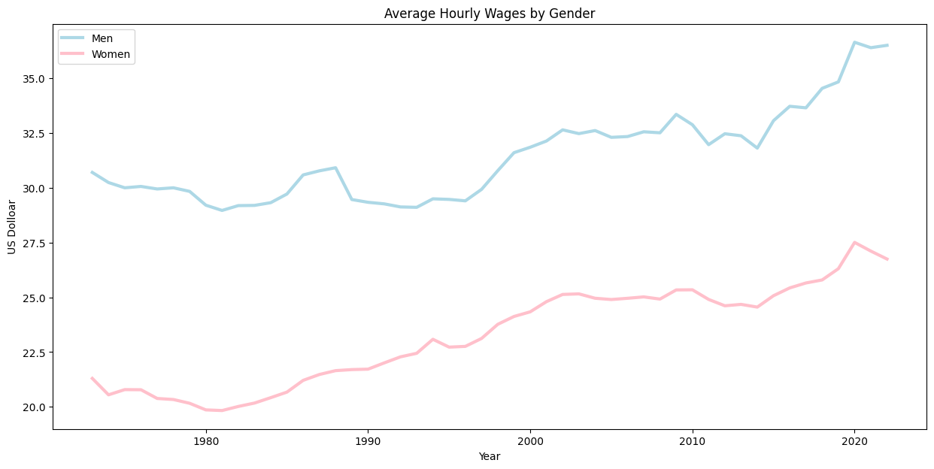
This chart illustrates the gender wage gap, highlighting the significant disparity between men and women in terms of earnings growth.

Slide 7
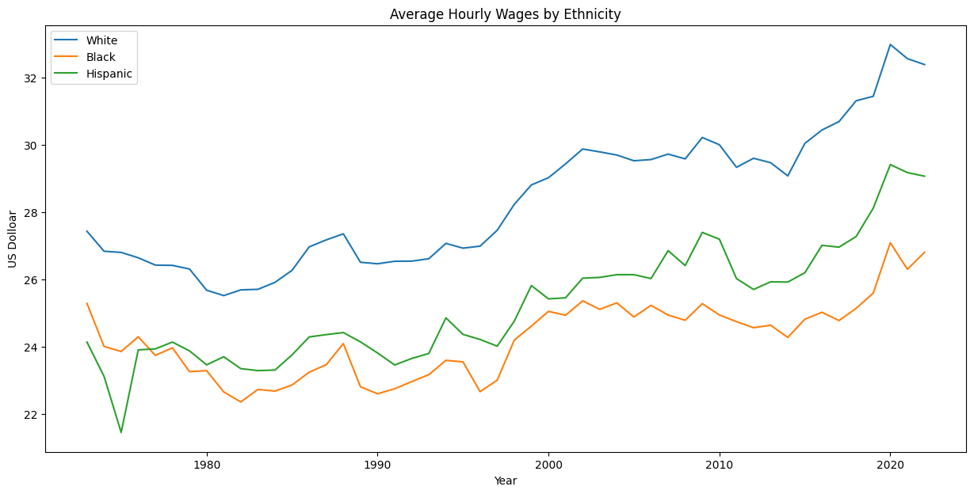
In the graph, we observe the wage growth and the income disparity among three different ethnic groups.

Slide 8
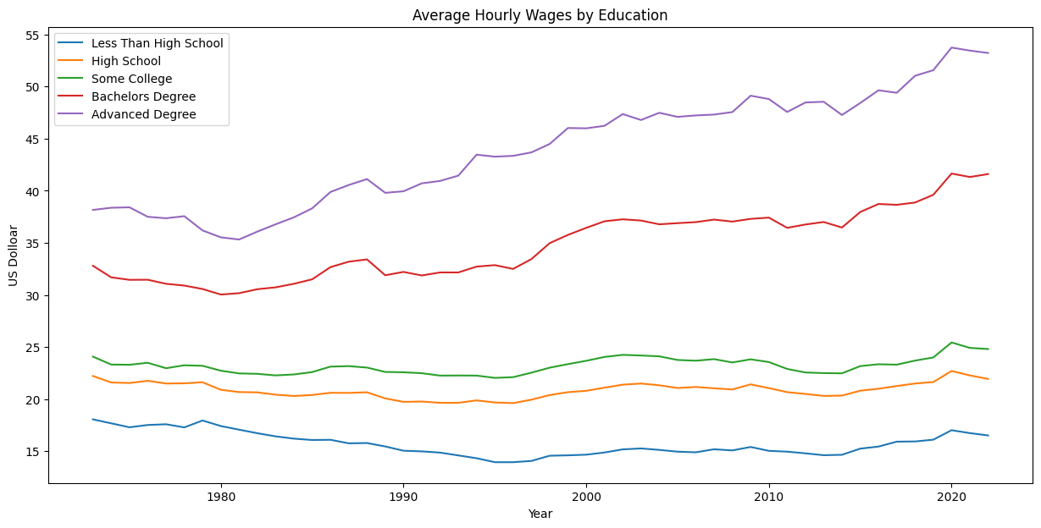
In the graph, we observe the wage growth and the income disparity among different educational groups.

Slide 9
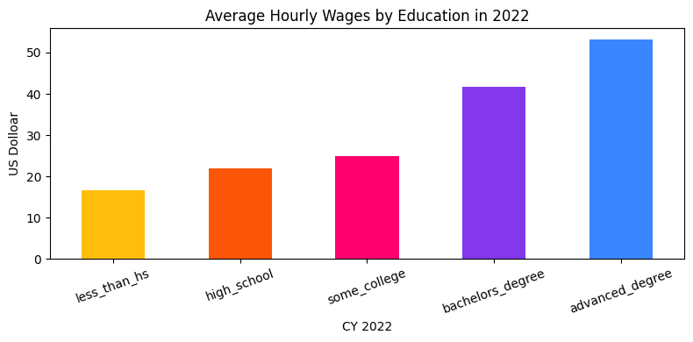
The chart illustrates how the average hourly rates differ across various educational levels in the year 2022 with figures denominated in thousands of dollars. Individuals holding advanced degrees earn more than twice the income of those with a high school diploma.

Slide 10
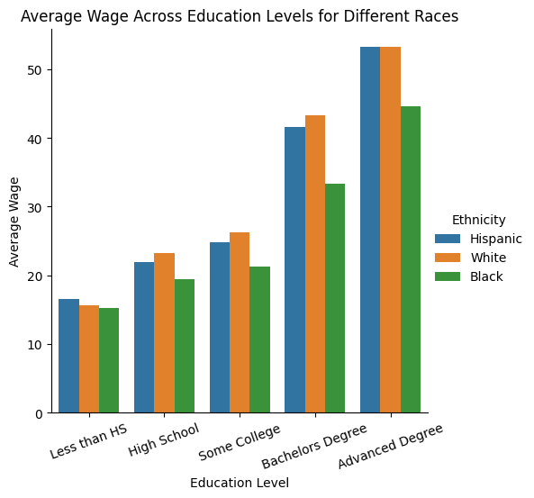
Despite individuals from various ethnic backgrounds having the opportunity to earn higher wages with increased educational attainment, a notable wage disparity persists among different ethnicities.

Slide 11
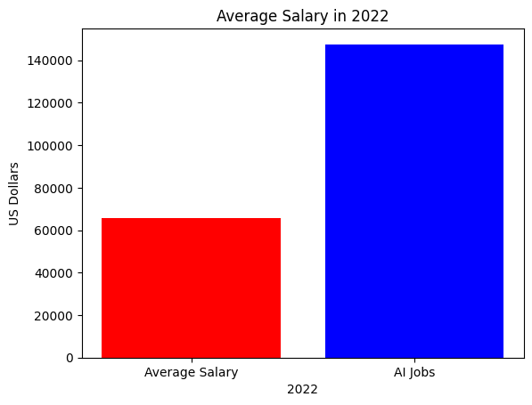
While educational level is important, other factors such as the job field and demand within that field significantly influence wages. In 2022, the average salary for AI jobs in the USA was twice the average salary for all jobs.

Slide 12
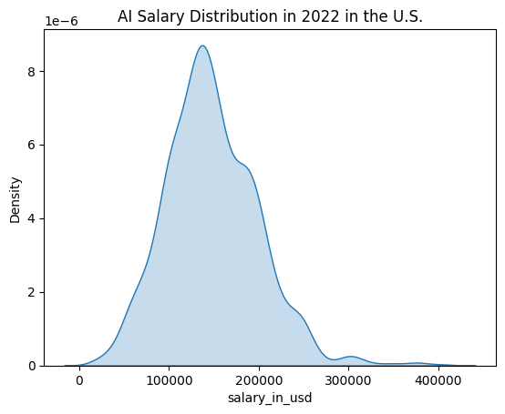
The graph illustrates the distribution of artificial intelligence (AI) salaries in the USA for the year 2022.

Slide 13
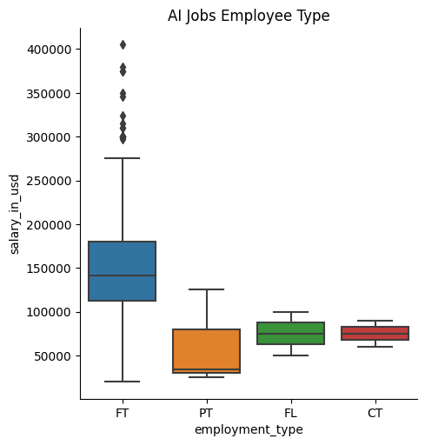
This graph illustrates the variation in AI-related job salaries across different employment types, including part-time, full-time, contract, and freelance positions. The median salary for full-time employees is three times higher than that for part-time employees. Some of them even earn salaries as high as $400,000. Interestingly, individuals working under contracts and freelancers have nearly equivalent median incomes.

Slide 14
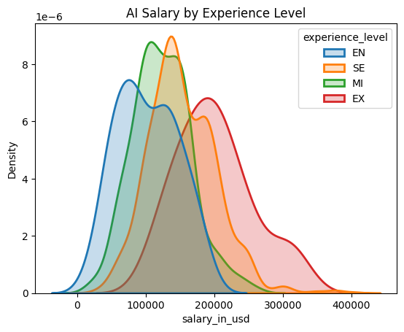
The graph illustrates that individuals with greater experience earn higher salaries.

Slide 15
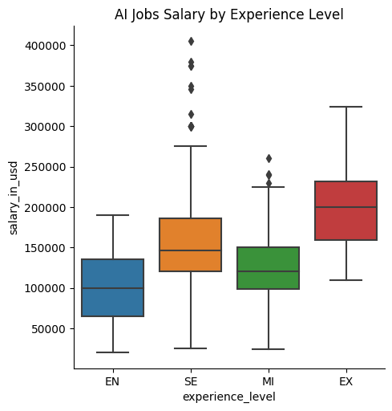
The median salary for experts is more than double that of entry-level salaries.

Slide 16
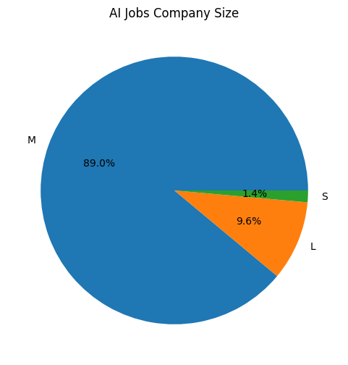
In the United States in 2022, medium-sized companies, with 50 to 250 employees, were responsible for 89% of the AI job opportunities examined in this report.

Slide 17

Here are some college majors that can lead to AI-related jobs:
Artificial Intelligence (AI): Specialized programs in AI cover topics like cognitive systems, natural language processing, and data structures. Students learn to create AI applications and algorithms for analyzing large datasets.
Computer Science: A popular choice, computer science programs often offer AI or machine learning courses. Students gain skills in robotics, database systems, and visual computing.
Data Science: Data science equips students with data analysis, machine learning, and statistical modeling skills. These are directly applicable to AI work.
Mathematics: Theoretical foundations for AI algorithms come from mathematics. Linear algebra, calculus, and probability theory are essential.
Statistics: Statistical knowledge is crucial for evaluating models and drawing insights from data.
Business Analytics: A business analytics degree prepares students to collect and interpret data for improving operations and staffing. Graduates may work in consulting agencies, technology companies, or research firms.

Slide 18
Thank you!
Tools and References:
https://www.indeed.com/career-advice/career-development/best-degree-for-artificial-intelligence
11 Jobs You Can Do With a Business Analytics Degree | Indeed.com
https://designer.microsoft.com

